Slide 1


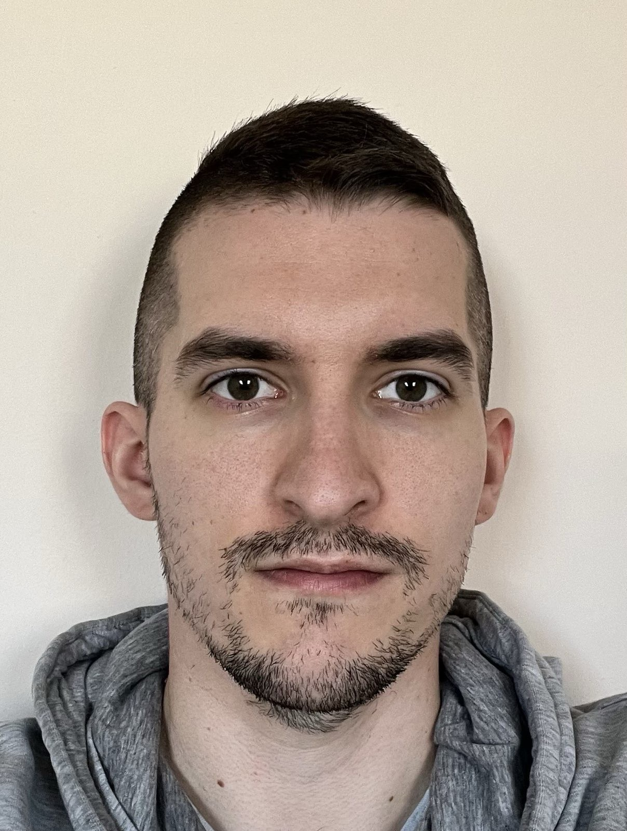

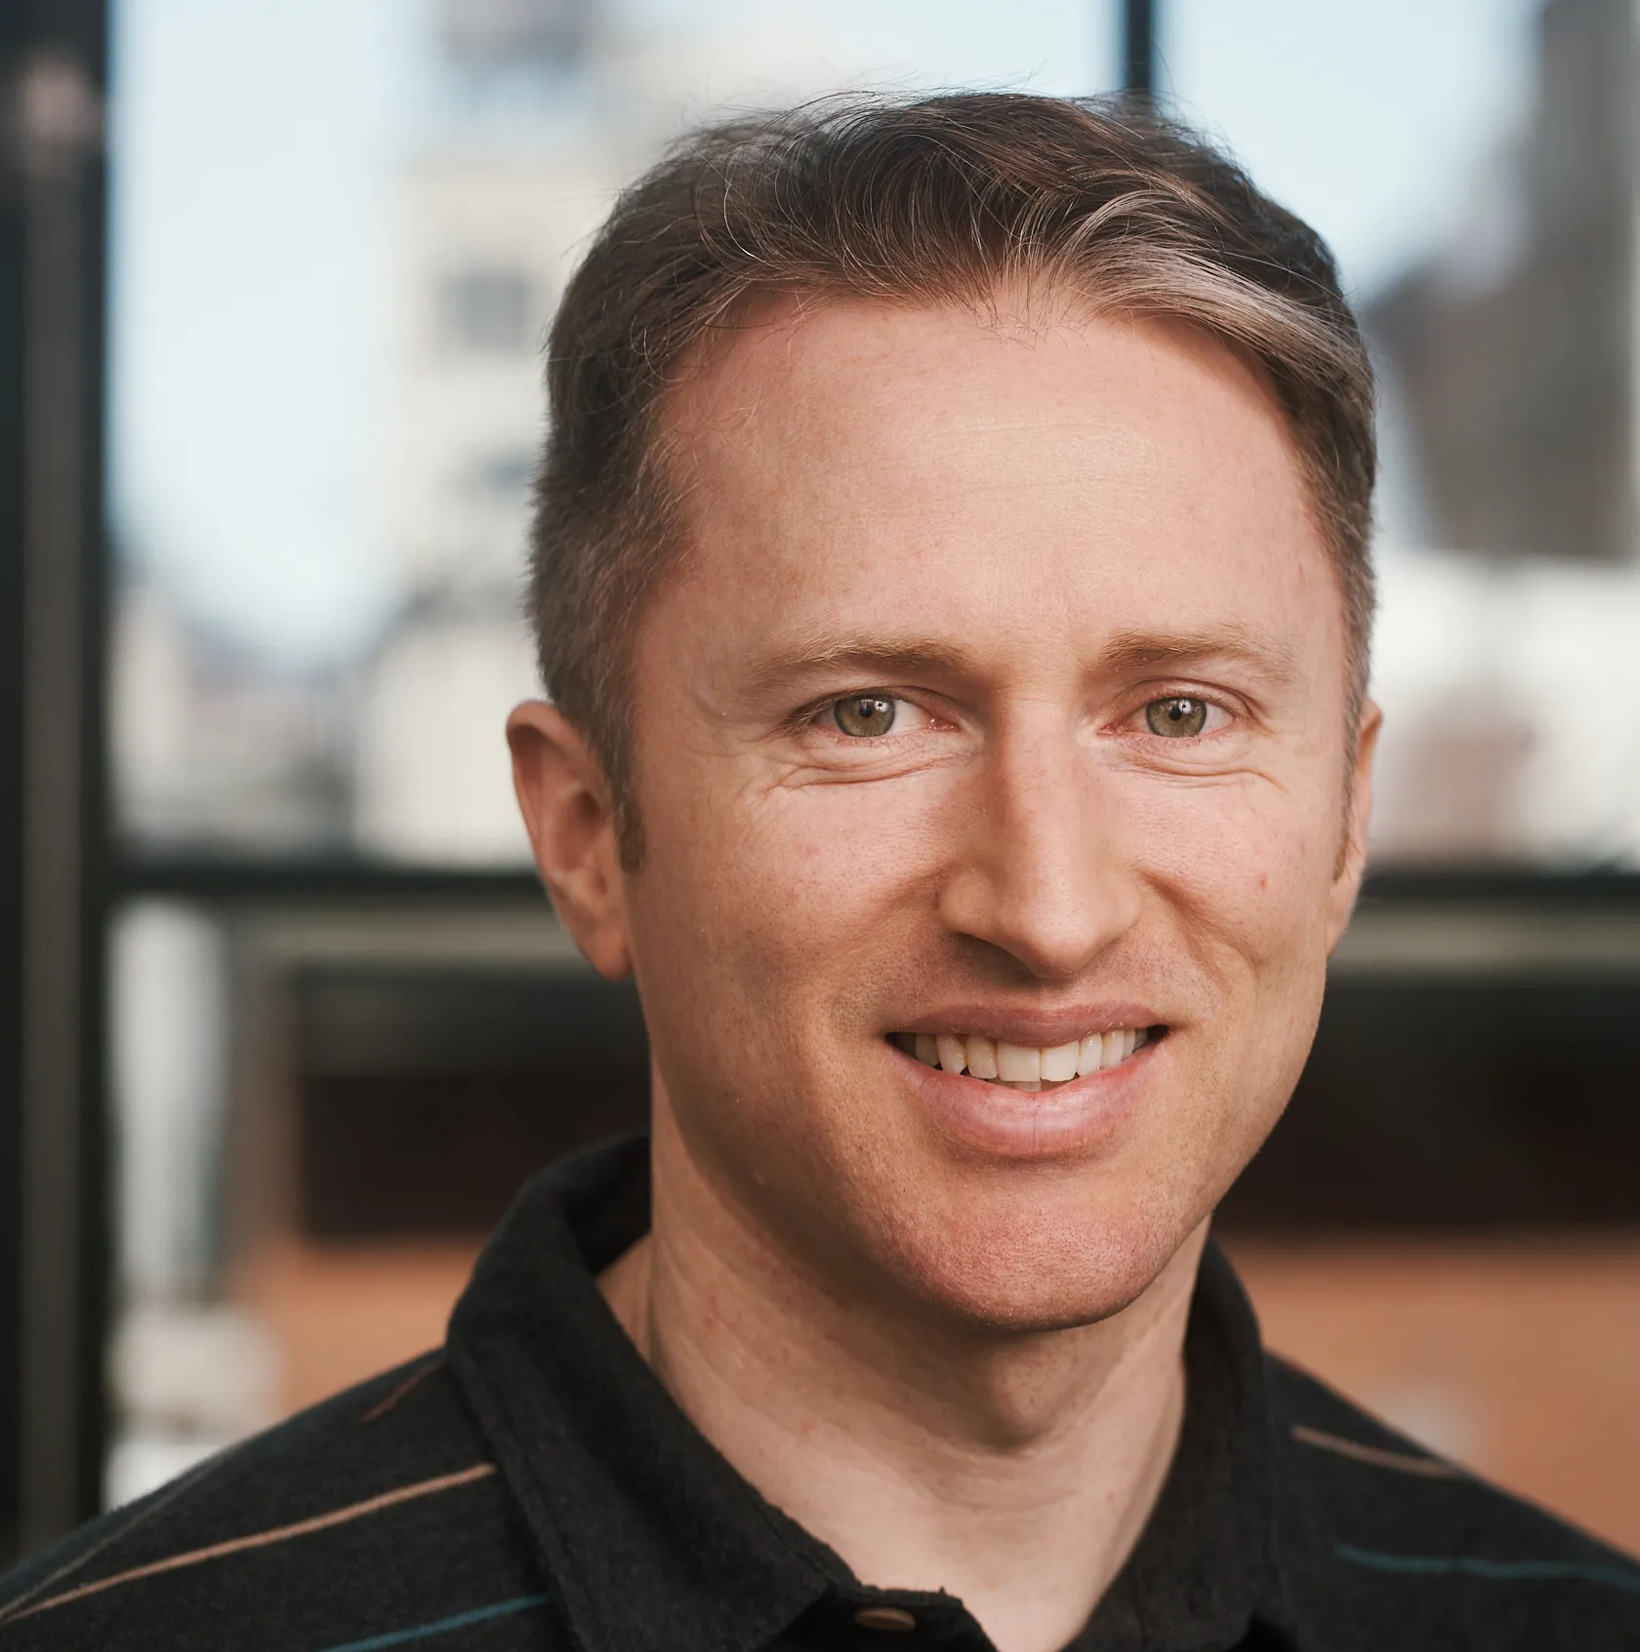
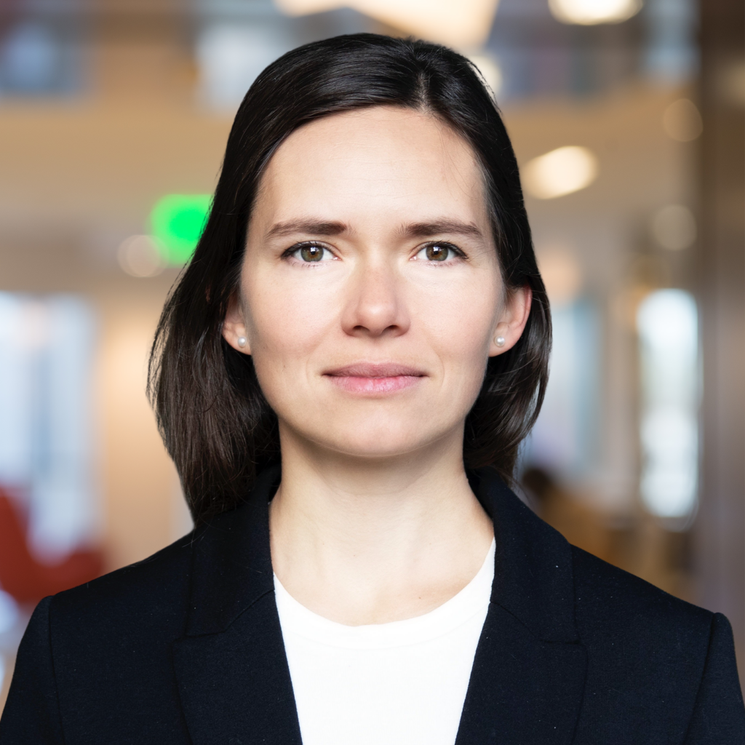
Atomic and Fair Data Exchange via Blockchain
Ertem Nusret Tas
Stanford University
The Science of Blockchain Conference 2024 (SBC’24)
István András Seres
Eötvös Loránd U.
Yinuo Zhang
UC Berkeley
Márk Melczer
Eötvös Loránd U.
Mahimna Kelkar
Cornell Tech
Joseph Bonneau
a16z crypto research
& NYU
Valeria Nikolaenko
a16 crypto research

Slide 2




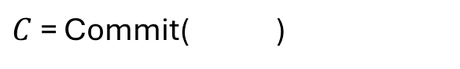
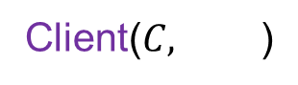
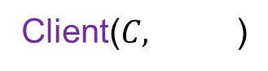
The Fair Data Exchange (FDE) Problem
$C$ = Commit( )
Data
Server( )
Server( , )
Client($C,$ )
Client($C,$ )
Data
Payment
Payment
Data
Data
Server Fairness:
An adversarial client cannot learn anything about the data without paying the server.
Correctness:
If the client and the server are honest, the client obtains the data, and the server obtains the payment.
Client Fairness:
An adversarial server cannot receive any payment if the client does not obtain the data.

Slide 3
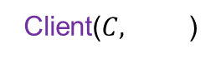
Applications of FDE over Blockchains
ProtoDanksharding (EIP-4844)
KZG Commitment $C$ = ${Commit}_{KZG}$( )
Blob
Data
Server( )
Client($C,$ )
Payment
Blob Data
Other Applications:
Other archival blockchain data
Data marketplaces (e.g., streaming movies, …)
Notes:
In ProtoDanksharding, validators store special kind of blockchain data designated for storage and not for execution, called blob-data. This blob-data eventually expires, but the KZG-commitment to the data is persisted. After expiry, servers might voluntarily continue storing it, but they are not required to. Solving the FDE problem would help incentivize servers to continue storing the data by enabling the client to purchase data in a trust-minimized and fair way.
Any other applications?
Our choice of KZG is due to two reasons: First, solving the FDE problem for KZG commitments enables our scheme to be applicable to ProtoDanksharding.

Slide 4
The Fair Data Exchange (FDE) Problem
‘On the Impossibility of Fair Exchange without a Trusted Third Party’, Pagnia and Gartner, 1999
Impossible without a trusted third party
TTP?
Blockchains!
$C$ = Commit( )
Data
Server( )
Client($C,$ )
Data
Payment
Server Fairness:
An adversarial client cannot learn anything about the data without paying the server.
Correctness:
If the client and the server are honest, the client obtains the data, and the server obtains the payment.
Client Fairness:
An adversarial server cannot receive any payment if the client does not obtain the data.

Slide 5

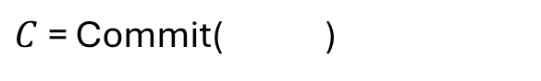

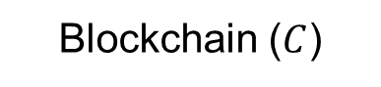
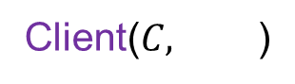
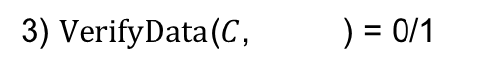
Strawman Solution
Blockchain ($C$)
3) $VerifyData$($C$, ) = 0/1
$C$ = Commit( )
Data
1) Locks payment
2) Sends the data
5) Reads the data
4) Withdraws coins
All data posted to the blockchains!
Limited capacity on blockchains
Server( )
Server( , )
Client($C,$ )
Client($C,$ )
Data
Payment
Payment
Data
Data

Slide 6

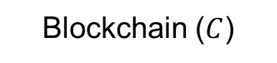
The FDE Protocol
Server encrypts the data.
Transfers the encrypted data off-chain (large off-chain bandwidth)
Sells the key on-chain (small on-chain bandwidth)
Server( )
Blockchain ($C$)
Client($C,$ )
Data
Payment
ciphertext
Server must prove that the key sold on-chain decrypts the ciphertext to the data committed by $C$!
Notes:
What if the ciphertext cannot be decrypted with the given key, or decrypts into data that does not match the commitment?

Slide 7
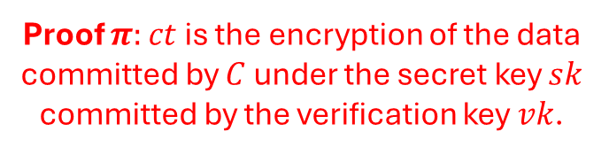
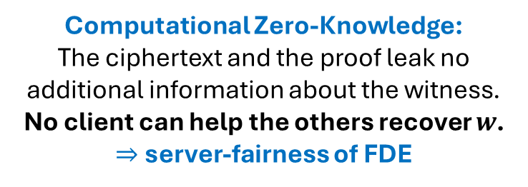
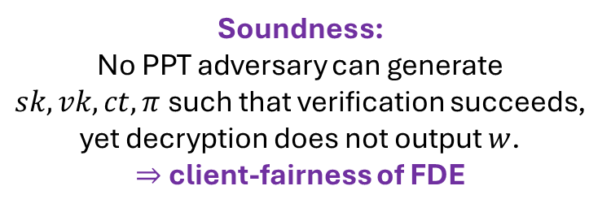
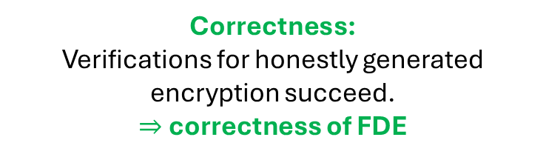
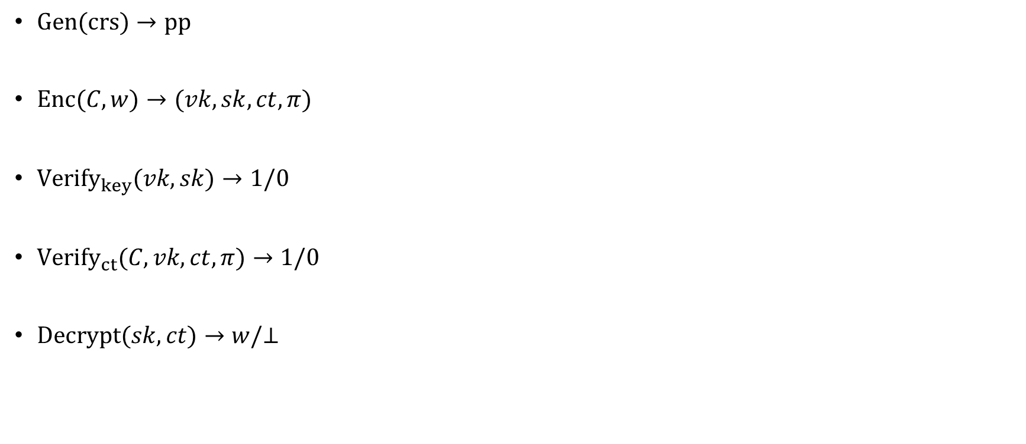
Verifiable Encryption under Committed Key (VECK)
Correctness:
Verifications for honestly generated encryption succeed.
$⇒$ correctness of FDE
$Gen(crs)→pp$
$Enc(C,w)→(vk,sk,ct,π)$
$Verify_{key}(vk,sk)→1/0$
$Verify_{ct}(C,vk,ct,π)→1/0$
$Decrypt(sk,ct)→w/⊥$
Proof $π:$ $ct$ is the encryption of the data committed by $C$ under the secret key $sk$ committed by the verification key $vk$.
Soundness:
No PPT adversary can generate $sk, vk, ct, π$such that verification succeeds, yet decryption does not output $w$.
$⇒$ client-fairness of FDE
Computational Zero-Knowledge:
The ciphertext and the proof leak no additional information about the witness.
No client can help the others recover $w$.
$⇒$ server-fairness of FDE
VECK for KZG Commitments: $w=φ,$ data $=\left(φ\left(0\right),…,φ\left(l\right)\right), C=Commit_{KZG}\left(φ\right)$
Notes:
The proof attests to the fact that the ciphertext ct is the encryption of the witness w committed by the commitment C under the secret key committed sk by the verification key vk.

Slide 8



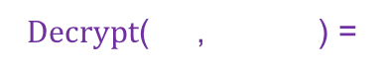
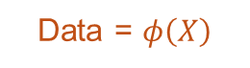
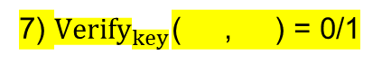


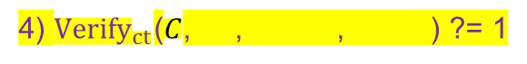
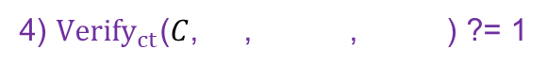
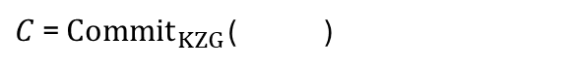
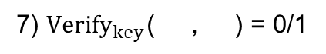
The FDE Protocol for KZG Commitments
7) ${Verify}_{key}$( , ) = 0/1
$C$ = ${Commit}_{KZG}$( )
Blockchain ($C$)
7) ${Verify}_{key}$( , ) = 0/1
Data = $φ\left(X\right)$
5) Locks payment
5) Locks payment
2) Sends verification key
2) Sends verification key
9) Reads secret key
9) Reads secret key
6) Sends secret key
6) Sends secret key
8) Withdraws coins
8) Withdraws coins
Server( )
3) Sends the ciphertext and proof
Client($C,$ )
3) Sends the ciphertext and proof
Payment
Data = $φ\left(X\right)$
4) ${Verify}_{ct}$($C$, , , ) ?= 1
1) $Enc$($C$, ) = (ver. key , secret key , ciphertext , proof )
4) ${Verify}_{ct}$($C$, , , ) ?= 1
1) $Enc$($C$, ) = (ver. key , secret key , ciphertext , proof )
10) Obtains the data
$Decrypt$( , ) =
Notes:
Fix the server-client issue.

Slide 9

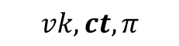


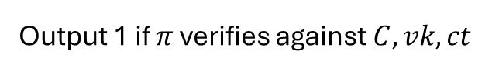

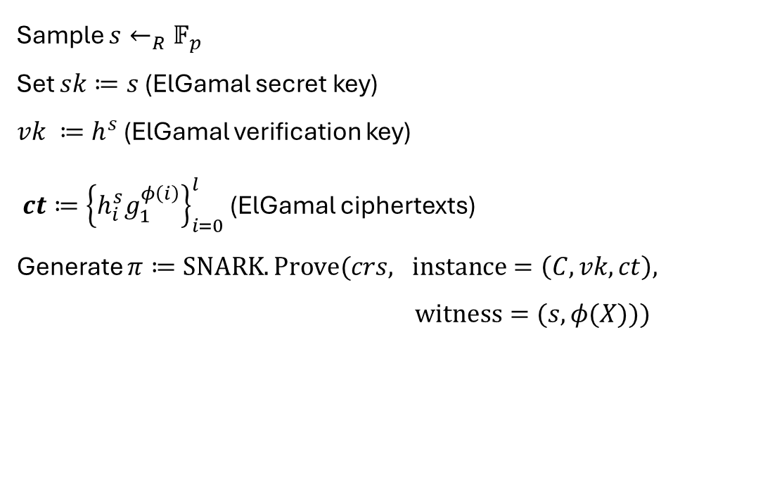

ElGamal-based VECK for KZG Commitments
$$pp=(h, h_{0},…,h_{l})$$
Prover (Server):
$$Enc(C, φ(X))→(sk,vk,ct, π)$$
Verifier (Client):
$${Verify}_{ct}(C, vk,ct,π)→0/1$$
Sample $s←_{R}𝔽_{p}$
Set $sk≔s$ (ElGamal secret key)
$vk ≔h^{s}$ (ElGamal verification key)
${ct≔\left\{h_{i}^{s}g_{1}^{φ\left(i\right)}\right\}}_{i=0}^{l}$ (ElGamal ciphertexts)
Generate $π≔SNARK.Prove(crs, instance=\left(C, vk,ct\right),$
$witness=(s,φ(X)))$
Output 1 if $π$ verifies against $C,vk,ct$
$$vk,ct,π$$
$$Decrypt(pp,sk,ct)→w/⊥$$
Data points: assume small
Decryption algorithm for ElGamal
Blockchain Contract:
$$Verify_{key}(pp,vk,sk)→1/0$$
Check if $h^{sk}==vk$
Notes:
They will definitely ask for numbers for generic SNARKs.

Slide 10
More on VECK for KZG Commitments
‘One Round Threshold Discrete-Log Key Generation without Private Channels’, Fouque and Stern, PKC 2001
Requires inclusion of the ‘encryption’ as part of the SNARK relation $→$ Potential effects on efficiency!
An efficient VECK protocol that exploits the (shared) structure of the ElGamal ciphertexts and KZG commitments!
Can support large messages by splitting the messages into $k∈[8,16]$ chunks with range proofs.
But, blows up ciphertext size by $k!$
Paillier-based VECK for KZG commitments to avoid the ciphertext blow-up!
Thm: Assuming Decisional Diffie-Hellman (DDH) assumption, ElGamal-based VECK protocol satisfies security (correctness, soundness and computational zero-knowledge) in the random oracle and algebraic group models.
Thm: Assuming Decisional Composite Residuosity (DCR) assumption, Paillier-based VECK protocol satisfies security in the random oracle and algebraic group models.
Notes:
Paillier-based VECK: Based on Fouque-Stern construction to recover DLOG values from the Paillier ciphertext.

Slide 11
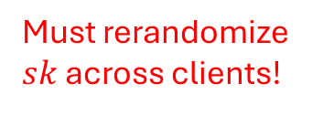
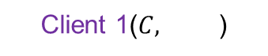
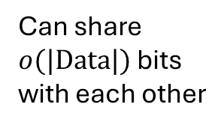
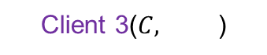
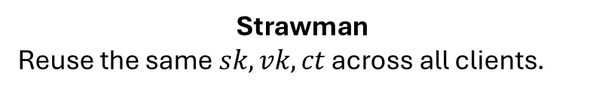
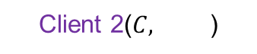

Multi-client Model
Blockchain ($C$)
Client 1($C,$ )
Strawman
Reuse the same $sk,vk,ct$ across all clients.
Client 2($C,$ )
Can share $o(|Data|)$ bits with each other
$$⇒$$
Must rerandomize $sk$ across clients!
Client 3($C,$ )
Multi-client VECK (MC-VECK) protocol:
Prover saves work by moving parts of the proof generation to a preprocessing step.
No need to generate new ciphertexts and range proofs per client!
…
Server( )
Data
Can the server save work by amortizing proof generation across many clients?
Notes:
Not showing the interaction between each client and the blockchain.
In the paper,
Security definitions for MC-VECK
ElGamal-based MC-VECK protocol

Slide 12
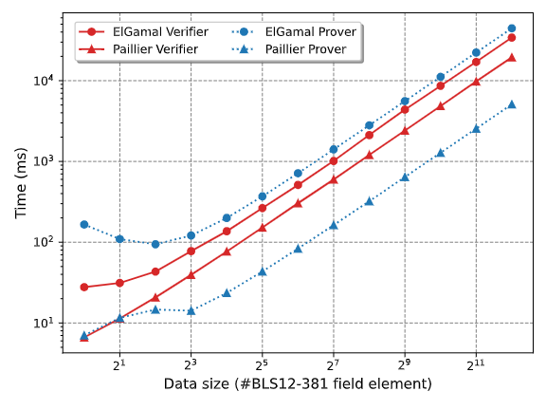
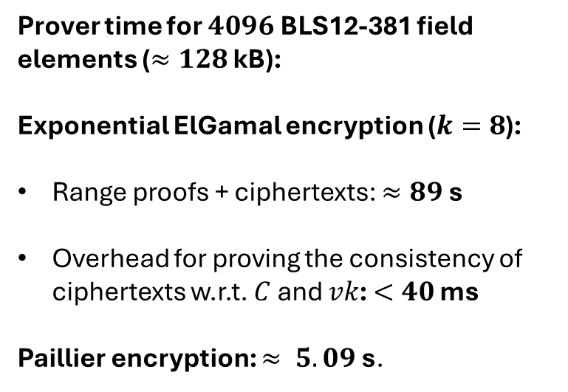
Implementation: Prover Time
PoC implementation in Rust v1.74.0 on consumer PC with AMD Ryzen 5 3600 (6-core) CPU and 8GB RAM.
Criterion benchmarking crate8.
Prover time for $4096$ BLS12-381 field elements ($≈128$ kB):
Exponential ElGamal encryption ($k=8$):
Range proofs + ciphertexts: $≈89$ s
Overhead for proving the consistency of ciphertexts w.r.t. $C$ and $vk$: $<40$ ms
Paillier encryption: $≈ 5.09$s.
Notes:
… to measure the execution time of the prover and the verifier.
Each measurement was repeated 10 times.
Implementation is a prototype and that a lot can be improved!
With multi-client VECK, we can avoid creating range proofs and ciphertexts for each client separately!
DON’T POINT OUT: Prover time in the exponential ElGamal protocol for a small number of exchanged points is dominated by the computation of the FFTs (i.e., computing the quotient polynomial q(X) when proving consistency). Therefore, we observe that the proving overhead is larger for transferring fewer BLS12-381 scalar field elements. However, for larger exchanged data, ElGamal encryption and the range proof generation dominate our ElGamal prover time.

Slide 13
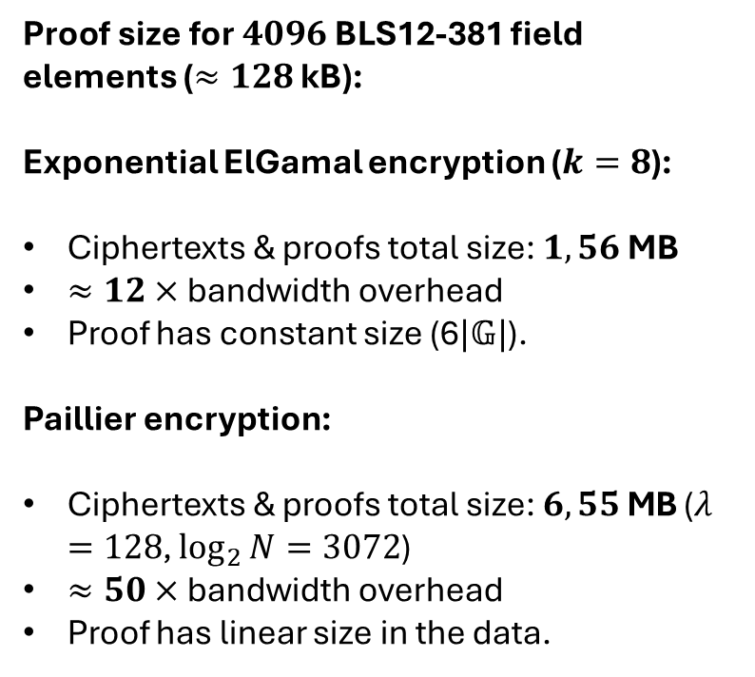
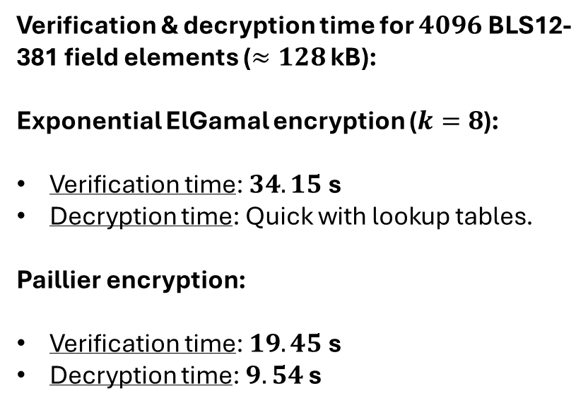
Implementation: Proof Size, Verification & Decryption
$\text{Pro}\text{of} \text{size} \text{for} 4096$ BLS12-381 field elements ($≈128$ kB):
Exponential ElGamal encryption ($k=8$):
Ciphertexts & proofs total size: $1,56$ MB
$≈12×$ bandwidth overhead
Proof has constant size (6$|𝔾|$).
Paillier encryption:
Ciphertexts & proofs total size: $6,55$MB ($λ=128$, $\log_{2}{N}=3072$)
$≈50×$ bandwidth overhead
Proof has linear size in the data.
Verification & decryption time for $4096$ BLS12-381 field elements ($≈128$ kB):
Exponential ElGamal encryption ($k=8$):
Verification time: $34.15$ s
Decryption time: Quick with lookup tables.
Paillier encryption:
Verification time: $19.45$ s
Decryption time: $9.54$ s
Notes:
We observe that the Paillier-based protocol does not improve concretely the bandwidth costs of the exponential ElGamal due to its larger cryptographic groups and the linear-sized VECK proofs. However, it might be possible to improve its proof size by packing more field elements into a single Paillier ciphertext!
Verification of ElGamal-based VECK is dominated by split scalar encryption verification, meaning that the verifier needs to check whether an encrypted field element is properly split into smaller field elements within the brute-forceable range.

Slide 14
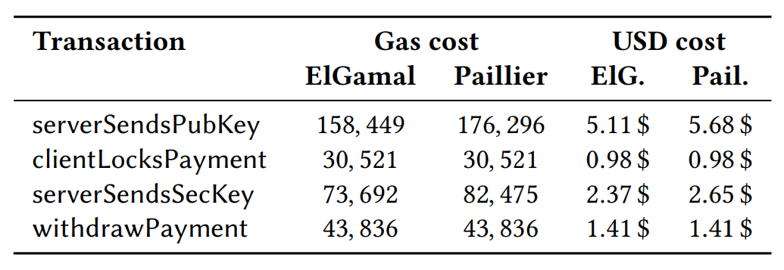
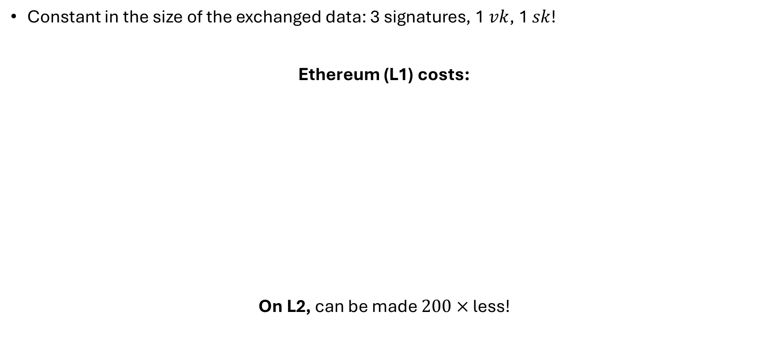
Implementation: On-chain Costs
Constant in the size of the exchanged data: 3 signatures, 1 $vk$, 1 $sk$!
Ethereum (L1) costs:
On L2, can be made $200×$ less!
Registers server’s verification key with the on-chain contract, sets the data price.
Locks client’s payment according to the set price
Verifies whether the server’s secret key matches the verification key
Enables the server to withdraw the payment
Notes:
DON’T READ THE NUMBERS! The smart contract implements four functionalities, and we report the EVM gas costs for each in the table. First, the server registers its public key on the blockchain in a compressed form, i.e., only the x-coordinate of its public key by calling the serverSendsPubKey function. Additionally, the server sets the agreed price of the exchanged data. Afterward, the client locks her payment by calling the clientLocksPayment function according to the previously agreed price. Third, the server sends the decryption key of the VECK scheme and calls the serverSendsSecKey function. This function ensures that the contract verifies that the provided decryption key sk matches the public key vk the server submitted in the first step. Finally, the parties can withdraw their money with the withdrawPayment function: the server can withdraw if it has provided the decryption key, while the client can withdraw its locked payment after a timeout if the server fails to reveal the decryption key sk for the data.

Slide 15



Conclusion and Future Directions
FDE and VECK protocols for KZG commitments with application to Danksharding.
More in the Paper:
Using Bitcoin as the TTP via adaptor sigs.
Supporting VECK for subset openings.
Framework to design alternative FDE & VECK protocols for different commitment schemes.
Future Directions:
Paillier-encryption with constant-size proofs.
Other commitment and encryption schemes?
Server griefing?
Pricing the data?
Blog post
Paper
Open-source implementation
Notes:
This is thanks to the ability to open KZG proofs into subsets of values.
Can we design a contract that prices the data based on clients’ demands?

Slide 16


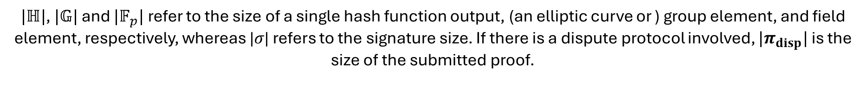
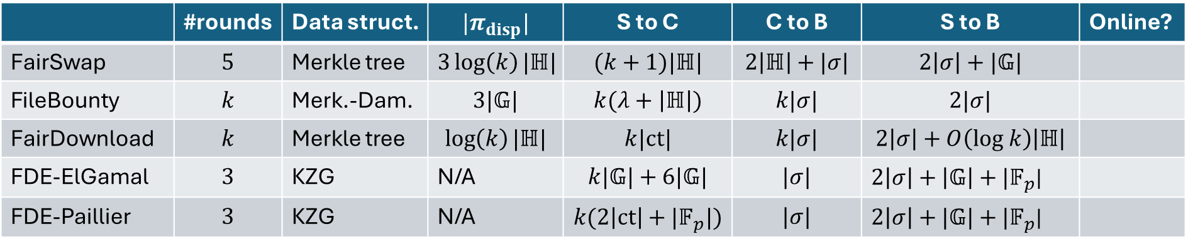
Appendix: Related Work
‘FairSwap: How To Fairly Exchange Digital Goods’ CCS 2018
‘Fair Peer-to-Peer Content Delivery via Blockchain’ ESORICS 2021
‘FileBounty: Fair Data Exchange’ IEEE EuroS&P 2020
‘ZKCPlus: Optimized Fair-exchange Protocol Supporting
Practical and Flexible Data Exchange’, CCS 2021
 | #rounds | Data struct. | $$|π_{disp}|$$ | S to C | C to B | S to B | Online?
FairSwap | $$5$$ | Merkle tree | $$3\log\left(k\right)|ℍ|$$ | $$(k+1)|ℍ|$$ | $$2\left|ℍ\right|+|σ|$$ | $$2\left|σ\right|+|𝔾|$$
FileBounty | $$k$$ | Merk.-Dam. | $$3|𝔾|$$ | $$k(λ+\left|ℍ\right|)$$ | $$k|σ|$$ | $$2|σ|$$
FairDownload | $$k$$ | Merkle tree | $$\log\left(k\right)|ℍ|$$ | $$k|ct|$$ | $$k|σ|$$ | $$2\left|σ\right|+O\left(log k\right)\left|ℍ\right|$$
FDE-ElGamal | $$3$$ | KZG | N/A | $$k|𝔾|+6|𝔾|$$ | $$|σ|$$ | $2\left|σ\right|+\left|𝔾\right|+|𝔽_{p}$|
FDE-Paillier | $$3$$ | KZG | N/A | $$k(2\left|ct\right|+|𝔽_{p}|)$$ | $$|σ|$$ | $2\left|σ\right|+|𝔾|+|𝔽_{p}$|
$|ℍ|$, $|𝔾|$ and $|𝔽_{p}|$ refer to the size of a single hash function output, (an elliptic curve or ) group element, and field element, respectively, whereas |𝜎| refers to the signature size. If there is a dispute protocol involved, $|π_{disp}|$ is the size of the submitted proof.
ZKCPlus: MiMC-p/p block cipher in CTR mode + commit-and-prove NIZKs (CP-NIZKs)
Notes:
Direct comparison with ZKCPlus was not technically possible, but comparing to NIZK+generic cipher solutions would be an interesting next step.
CP-NIZK is efficient for data parallel circuits.
An arithmetic circuit is data-parallel if it consists of multiple copies of identical sub-circuits running on separated inputs.

Slide 17
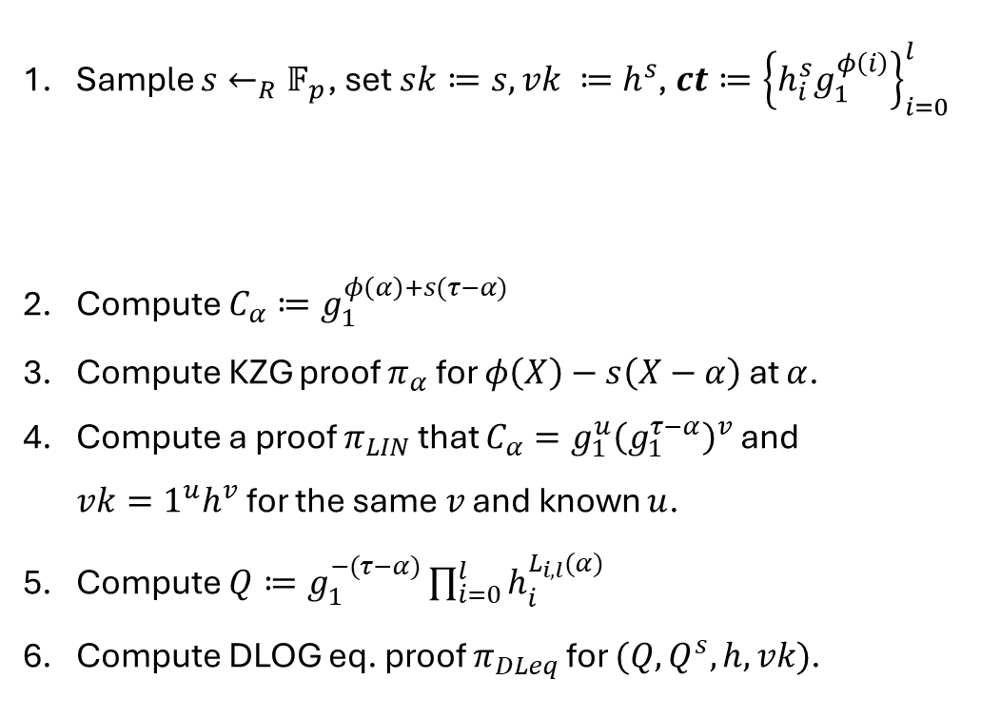


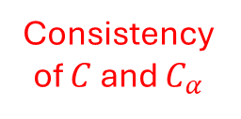

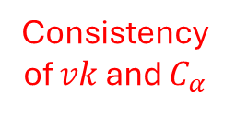
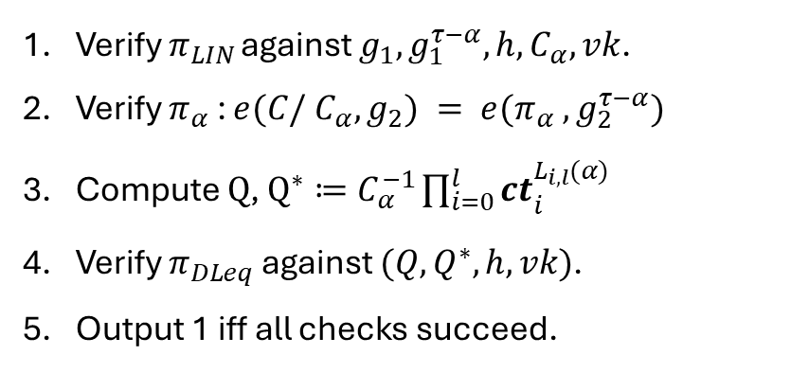
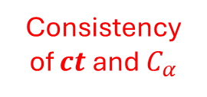
Appendix: ElGamal-based VECK for KZG Commitments
Prover (Server):
$$Enc(C, φ(X))→(sk,vk,ct, π)$$
Verifier (Client):
$${Verify}_{ct}(C, vk,ct,π)→0/1$$
Sample $s←_{R}𝔽_{p}$, set $sk≔s, vk ≔h^{s}$, ${ct≔\left\{h_{i}^{s}g_{1}^{φ\left(i\right)}\right\}}_{i=0}^{l}$
Compute $C_{α}≔g_{1}^{φ\left(α\right)+s(τ−α)}$
Compute KZG proof $π_{α}$ for $φ\left(X\right)−s\left(X−α\right)$ at $α$.
Compute a proof $π_{LIN}$ that $C_{α}=g_{1}^{u}{\left(g_{1}^{τ−α}\right)}^{v}$ and $vk={1^{u}h}^{v}$ for the same $v$ and known $u$.
Compute $Q≔g_{1}^{−(τ−α)}\prod_{i=0}^{l}{h_{i}^{L_{i,l}(α)} }$
Compute DLOG eq. proof $π_{DLeq}$ for $(Q,Q^{s},h,vk)$.
$$vk,ct$$
Can be made non-interactive with Fiat-Shamir
$$α←_{R}𝔽_{p}$$
To ensure zero-knowledge
$$π=(C_{α},π_{α}π_{LIN},π_{DLeq})$$
Consistency of $C$ and $C_{α}$
Verify $π_{LIN }$against $g_{1},g_{1}^{τ−α},h,C_{α},vk$.
Verify $π_{α}$ : $e(C/ C_{α},g_{2}) = e(π_{α} , g_{2}^{τ−α})$
Compute $Q$, $Q^{∗}≔C_{α}^{−1}\prod_{i=0}^{l}{{ct}_{i}^{L_{i,l}(α)} }$
Verify $π_{DLeq}$ against $(Q,Q^{∗},h,vk)$.
Output 1 iff all checks succeed.
Consistency of $vk$ and $C_{α}$
Consistency of $ct$and $C_{α}$

Slide 18
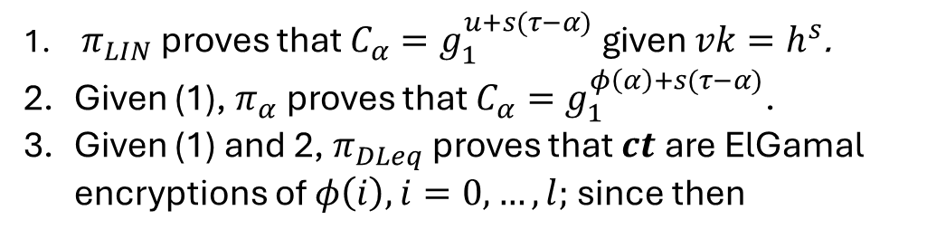
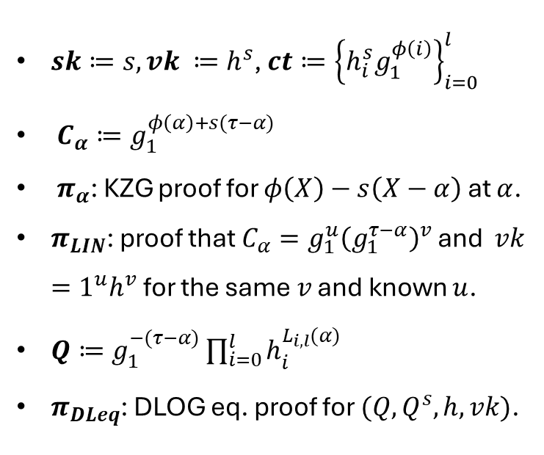
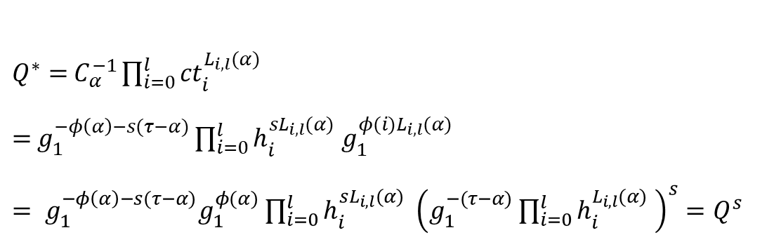
Appendix: ElGamal-based VECK for KZG Commitments
Why is it secure?
$sk≔s, vk ≔h^{s}$, ${ct≔\left\{h_{i}^{s}g_{1}^{φ\left(i\right)}\right\}}_{i=0}^{l}$
$C_{α}≔g_{1}^{φ\left(α\right)+s(τ−α)}$
$π_{α}$: KZG proof for $φ\left(X\right)−s\left(X−α\right)$ at $α$.
$π_{LIN}$: proof that $C_{α}=g_{1}^{u}{\left(g_{1}^{τ−α}\right)}^{v}$ and $vk={1^{u}h}^{v}$ for the same $v$ and known $u$.
$Q≔g_{1}^{−(τ−α)}\prod_{i=0}^{l}{h_{i}^{L_{i,l}(α)} }$
$π_{DLeq}$: DLOG eq. proof for $(Q,Q^{s},h,vk)$.
$π_{LIN}$ proves that $C_{α}=g_{1}^{u+s(τ−α)}$ given $vk=h^{s}$.
Given (1), $π_{α}$ proves that $C_{α}=g_{1}^{φ\left(α\right)+s(τ−α)}$.
Given (1) and 2, $π_{DLeq}$ proves that $ct$are ElGamal encryptions of $φ\left(i\right), i=0,…,l;$ since then
$Q^{∗}=$ $C_{α}^{−1}\prod_{i=0}^{l}{{ct}_{i}^{L_{i,l}(α)} }$
$=$ $g_{1}^{−φ\left(α\right)−s(τ−α)}\prod_{i=0}^{l}{h_{i}^{sL_{i,l}(α)} g_{1}^{φ(i)L_{i,l}(α)}}$
$= g_{1}^{−φ\left(α\right)−s(τ−α)}g_{1}^{φ(α)}$ $\prod_{i=0}^{l}{h_{i}^{sL_{i,l}(α)} }{\left(g_{1}^{−(τ−α)}\prod_{i=0}^{l}{h_{i}^{L_{i,l}(α)} }\right)}^{s}=Q^{s}$

Slide 19
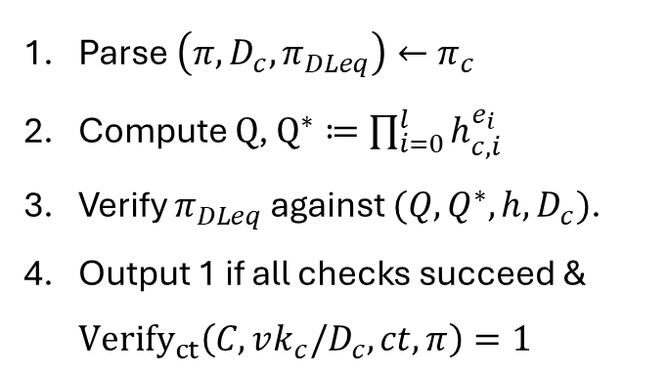







Appendix: Multi-client VECK Protocol
Prover saves work by moving parts of the proof generation to a preprocessing step.
Prover (Server) Preprocessing:
$$Prep(C, φ(X)) → (aux, msk)$$
Verifier (Client):
$${Verify}_{ct}(C, vk_{c},ct,π_{c})→0/1$$
Run $Enc(C, φ(X))→(sk,vk,ct, π)$
Output $aux=(vk,ct, π)$ and $msk=sk$
Parse$\left(π,D_{c},π_{DLeq}\right)←π_{c}$
Compute $Q$, $Q^{∗}≔\prod_{i=0}^{l}{h_{c,i}^{e_{i}} }$
Verify $π_{DLeq}$ against $(Q,Q^{∗},h,D_{c})$.
Output 1 if all checks succeed & ${Verify}_{ct}\left(C, vk_{c}/D_{c},ct,π\right)=1$
Prover (Server) per client $c$:
$$Enc(aux, msk)→(sk_{c},vk_{c},ct,π_{c})$$
To rerandomize $sk$
Sample $δ_{c}←_{R}𝔽_{p}$
Calculate $Q=\prod_{\left\{i∈\left[n\right]\right\}}{h_{i}^{e_{i}}}$, where $e_{i}≔H(h^{δ_{c}},i)$.
Compute DLOG eq. proof $π_{DLeq}$ for $(Q,Q^{δ_{c}},h,h^{δ_{c}})$.
$sk_{c}≔sk+δ_{c} ,vk_{c}≔vk⋅h^{δ_{c}}$,
$$π_{c}=\left(π,D_{c}≔h^{δ_{c}},π_{DLeq},{\left(h_{c,i}≔h_{i}^{δ_{c}}\right)}_{i=0}^{l}\right)$$
Consistency of $h_{c,i}$ and $D_{c}$
Notes:
Move to Appendix, any more feedback.

Slide 20
Appendix: The FDE Problem
Limited capacity for data on blockchains
Layer-2 solutions with proof-of-storage / proof-of-replication
But…
A malicious server might never serve the data despite storing.
Transferring the data itself is costly and the servers must be compensated.
We need a fair-exchange protocol for data and payment!
Even though fair exchange is impossible without a trusted third party…
We have blockchains!
Notes:
While blockchains were originally conceived as payment systems, it was quickly observed that they could also be used for data storage.
However, they are highly limited in both storage and computational capacity, making on-chain data storage quite expensive.
Limited on-chain capacity has led to the development of so-called layer-2 solutions such as rollups, validiums for both computation and data storage. These solutions perform computation and store data off-chain while enabling the layer-1 blockchain to verify off-chain computation via SNARKs and off-chain storage via proofs-of-storage and replication. In particular, the blockchain typically receives a succinct commitment to the data uploaded to the servers. It can then use the commitment to verify proofs-of-storage/replication or retrievability.

Slide 21




Appendix: The FDE Problem
Server Fairness:
An adversarial client cannot learn anything about the data without paying the server.
Client Fairness:
An adversarial server cannot receive any payment if the client does not obtain the data.
Blockchain Contract ($C$)
Correctness:
If the client and the server are honest, the client obtains the data, and the server obtains the payment.
$C$ = Commit( )
Data
Client($C,$ )
Server( , )
Client($C,$ )
Server( )
Payment
Data
Payment
Data
Data
KZG commitments and Application to ProtoDanksharding (EIP-4844)
Notes:
Our choice of KZG is due to two reasons: First, solving the FDE problem for KZG commitments enables our scheme to be applicable to ProtoDanksharding. In ProtoDanksharding, validators store special kind of blockchain data designated for storage and not for execution, called blob-data. This blob-data eventually expires, but the KZG-commitment to the data is persisted. After expiry, servers might voluntarily continue storing it, but they are not required to. Solving the FDE problem would help incentivize servers to continue storing the data by enabling the client to purchase data in a trust-minimized and fair way.

Slide 22


Verifiable Encryption under Committed Key (VECK)
Correctness:
Verifications for honestly generated encryption succeed.
$Gen(crs)→pp$
$Enc(pp,F,C,w)→(vk,sk,ct,π)$
$Verify_{ct}(pp,F,C,vk,ct,π)→1/0$
$Verify_{key}(pp,vk,sk)→1/0$
$Decrypt(pp,sk,ct)→F(w)/⊥$
Soundness:
No probabilistic polynomial time adversary can generate $sk, vk, ct, π$such that verification succeeds, yet decryption does not output $F(w)$.
Computational Zero-Knowledge:
The ciphertext and the proof leak no additional information about the witness.
VECK for KZG Commitments: $w=φ\left(X\right), C=Commit_{KZG}\left(φ\right), F_{\left[l\right]}^{full−eval}(φ)=\left(φ\left(0\right),…,φ\left(l\right)\right)∈𝔽_{p}^{l+1}$

